Slide 1
Covid-19 Vaccines
(https://serendipstudio.org/exchange/bioactivities/coronavirusvaccine)

Slide 2
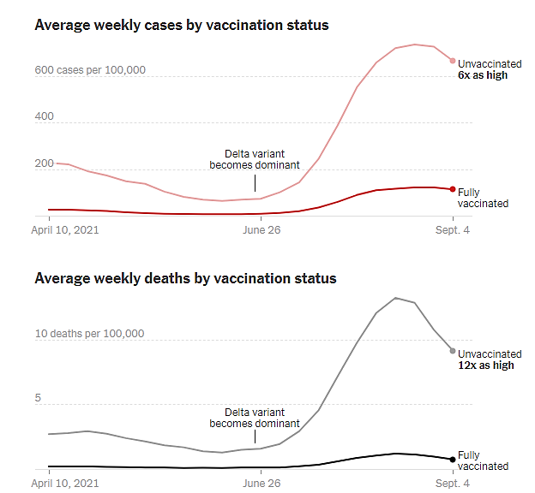
Recent Covid-19 Trends for Vaccinated vs. Unvaccinated People in the US
The data are for 14 states and two cities in the US. As of October 2021, approximately 92% of vaccinated people in the US had received either of the mRNA vaccines and 8% had received the Johnson & Johnson vaccine.
(https://www.nytimes.com/interactive/2021/10/28/us/covid-breakthrough-cases.html)

Slide 3
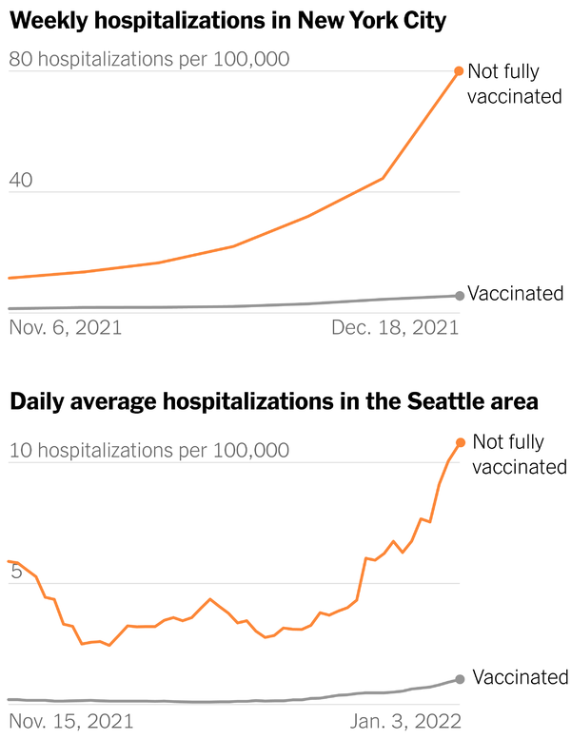
The increase in cases at the end of 2021 and the beginning of 2022 was due to the spread of the Omicron variant. (https://www.nytimes.com/2022/01/11/briefing/omicron-deaths-vaccinated-vs-unvaccinated.html)

Slide 4
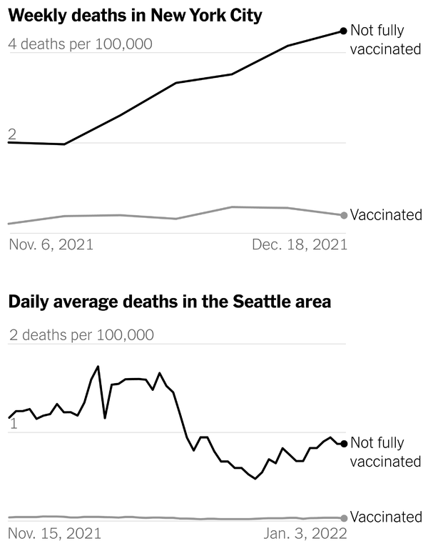
The increase in cases at the end of 2021 and the beginning of 2022 was due to the spread of the Omicron variant. (https://www.nytimes.com/2022/01/11/briefing/omicron-deaths-vaccinated-vs-unvaccinated.html)

Slide 5
